Slide 1
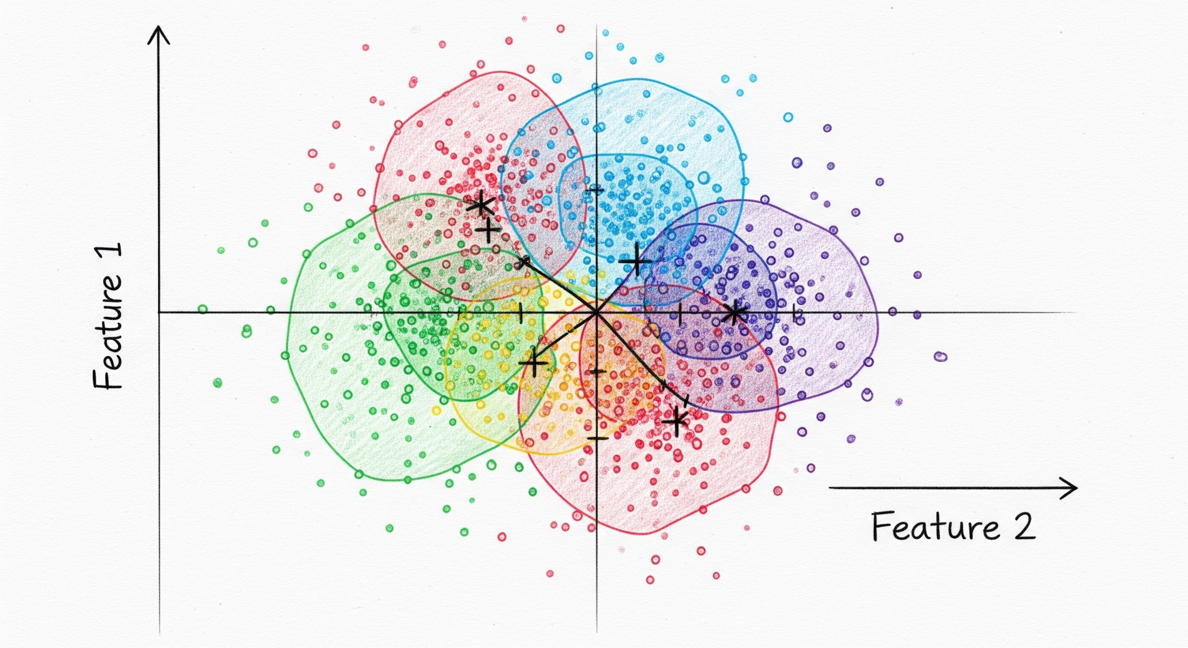
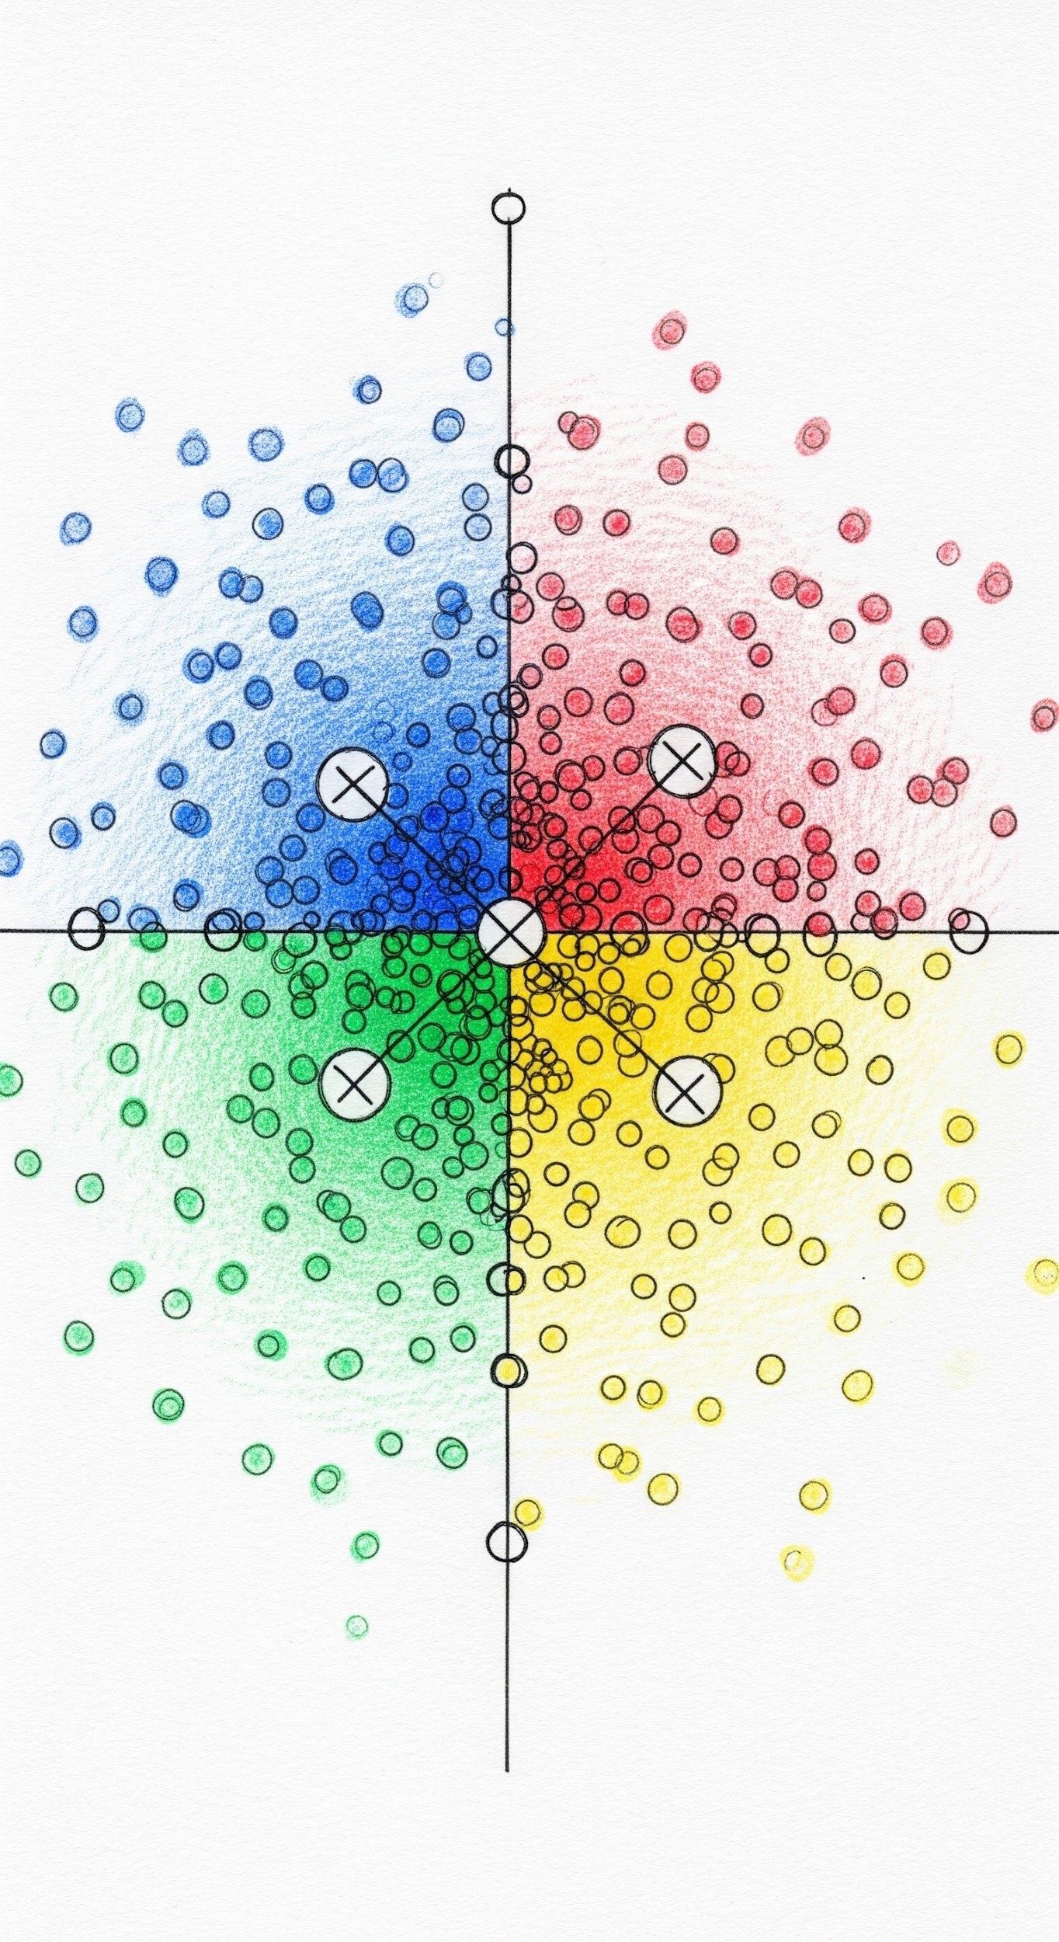
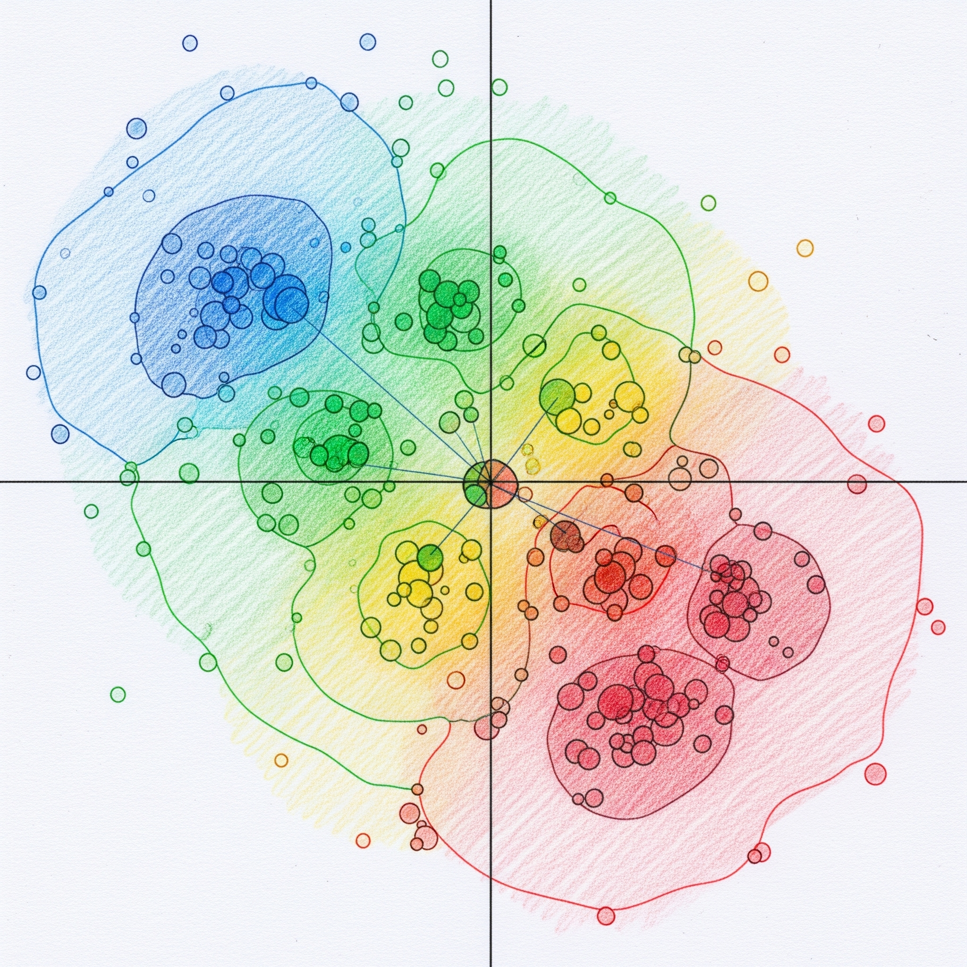
10/22/2025
Joel Martinez
Lunch & Learn:
Segmentation

Slide 2

Segmentation
Grouping respondents based on similarity

Slide 3
Response Similarity
Algorithms
Metrics
Data
Different algorithms calculate similarity differently
Different metrics capture different dimensions of similarity
Data format and type can change degree & meaning of similarity
K means
Centroid + spherical distance
Hierarchical clustering
Pairwise similarity
DBSCAN
Neighbor + density similarity
Spectral Clustering
Graph kernel
Mixture Models
Probablistic
Latent Class Analysis
Probablistic
Magnitude Similarity
Euclidean
Jaccard
Manhattan
Pattern Similarity
Correlation
Cosine
Euclidean
Jaccard
Continuous
vs.
Categorical
Raw data
vs
Similarity Matrix
These analytic decisions affect the cluster results you get!

Slide 4
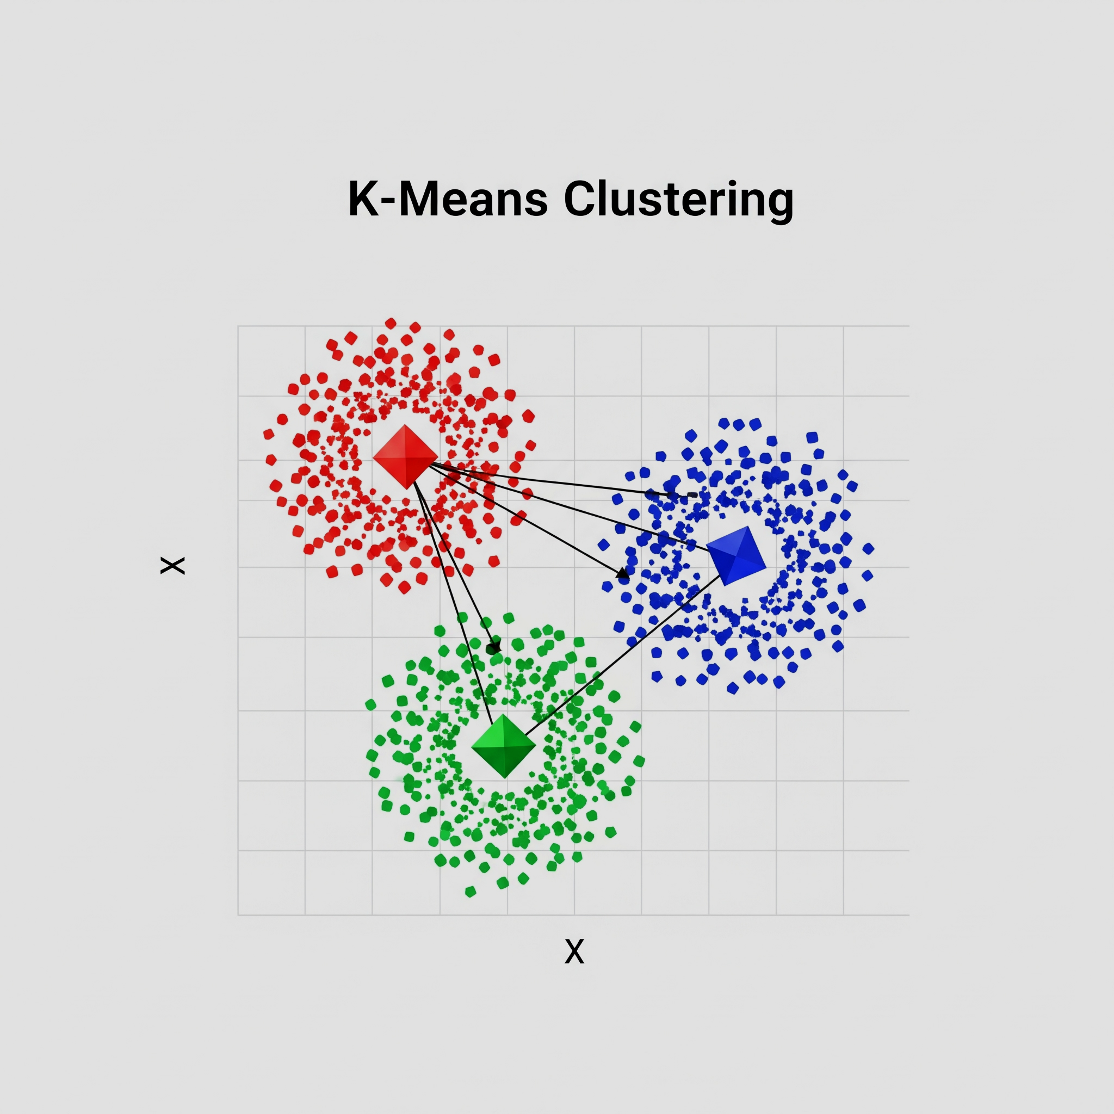
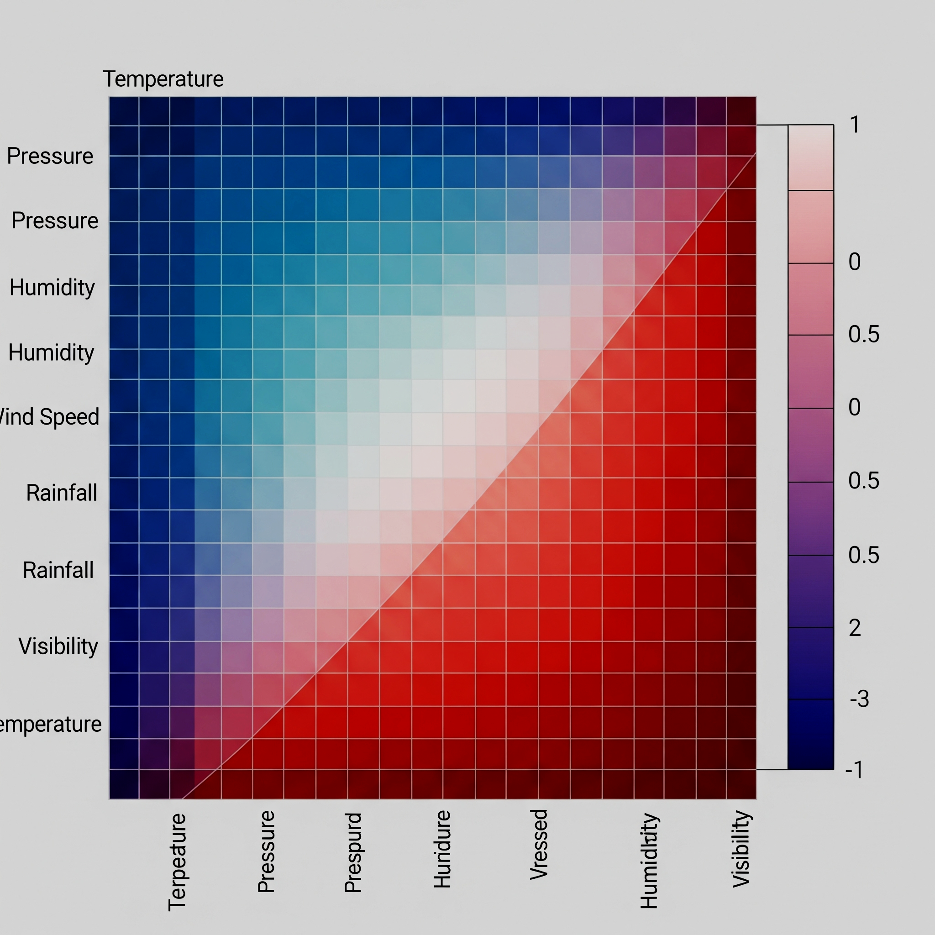
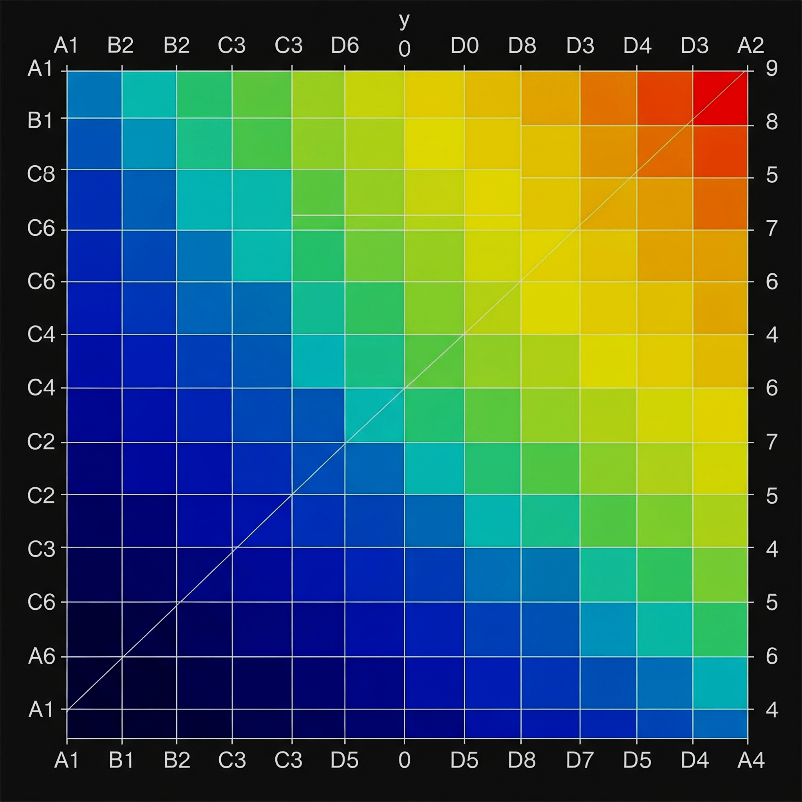
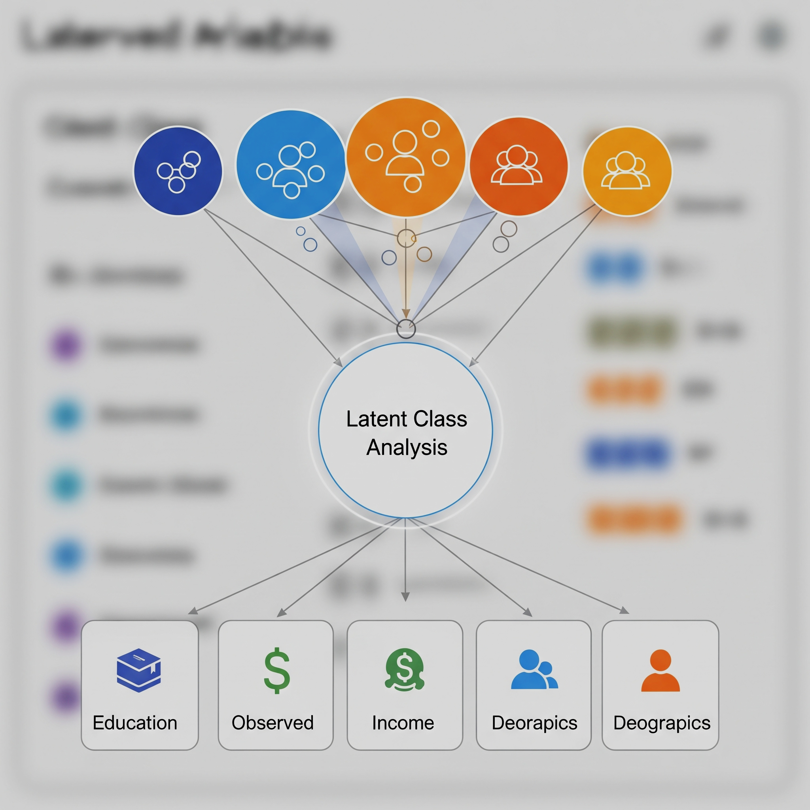
Comparisons
1.
2.
3.
4.
K Means +
Raw Data
K Means + Correlation Similarity Matrix
K Means +
Jaccard Similarity Matrix
Latent Class Analysis +
Raw Data

Slide 5
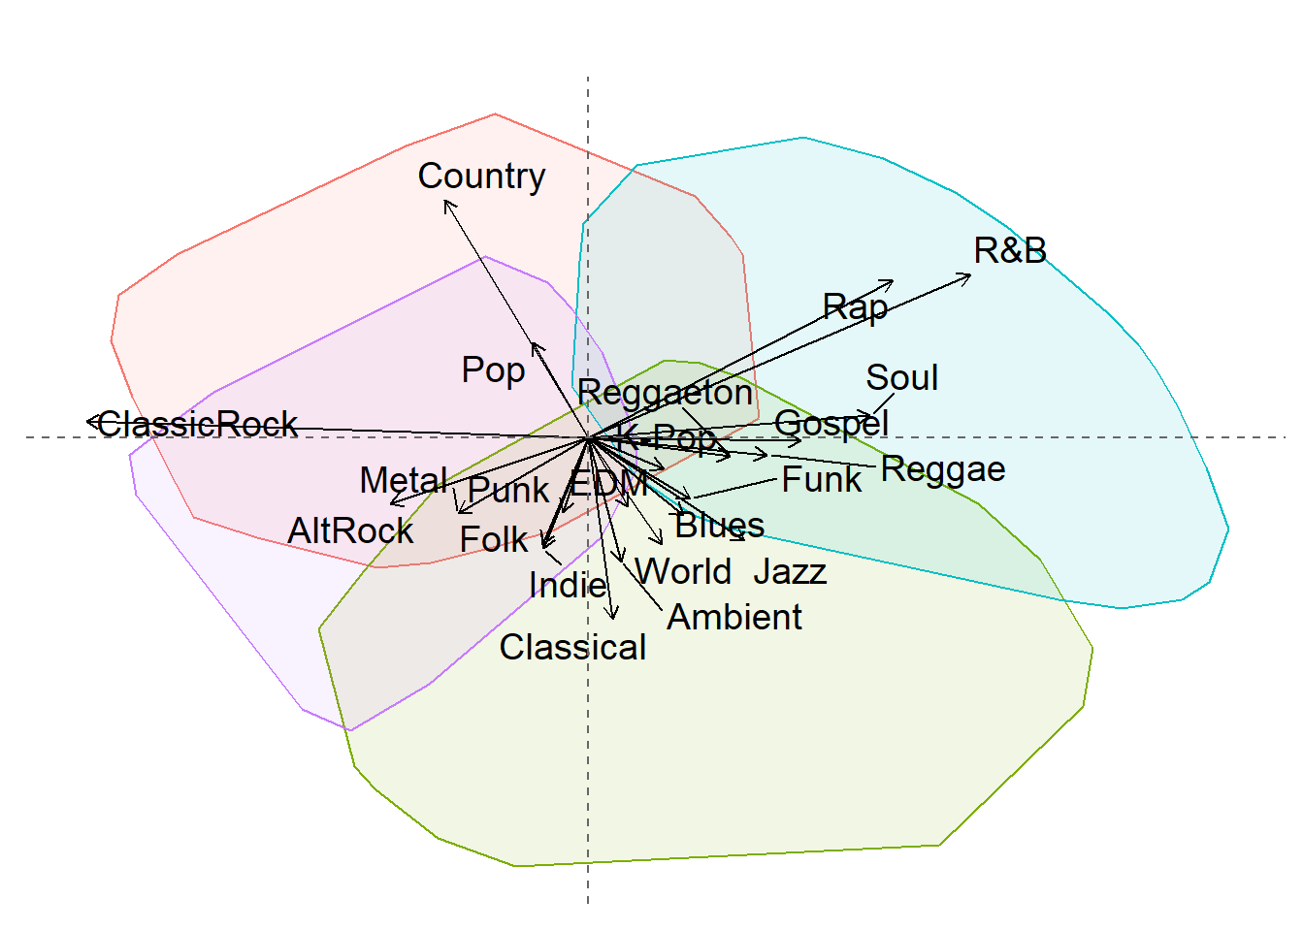
Dataset: Genre Preferences
How do music clusters change?
Data: 22 genres, multi-select, exclude “none of the above”
For all analyses, I ran a 4 cluster solution but changed the data preprocessing or the algorithm.

Slide 6
K Means + Raw Data
‹#›
Raw Data
Person | AltRock | Ambient | Blues | ClassicRock | …
A | 0 | 1 | 0 | 1 | …
B | 1 | 1 | 1 | 1 | …
C | 0 | 1 | 1 | 0 | …
Profile
Cluster Assignment
K Means K = 4; Euclidean Distance
Principal Component Analysis (PCA)
[0: Not Selected] [1: Selected]
Biplot Visualization

Slide 7
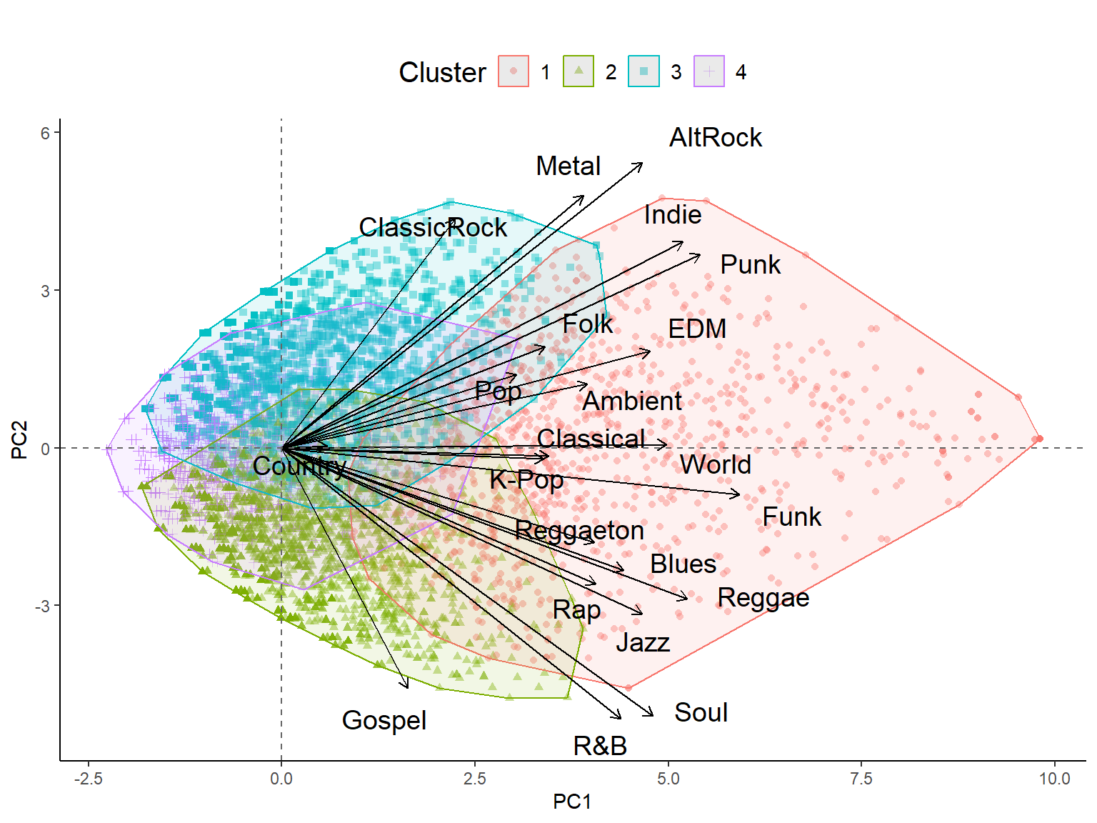
‹#›
Americana
Selects
Less Genres
Musical Heritage
Selects More Genres
Afro-Diasporic
Magnitude

Slide 8
‹#›
Americana
Cluster 1: Most interested (generalists)
Cluster 2: Prefer Afro-Diasporic
Selects
Less Genres
Musical Heritage
Selects More Genres
Cluster 3: Prefer Americana
Afro-Diasporic
Cluster 4: Least Interested (picky)
Magnitude

Slide 9
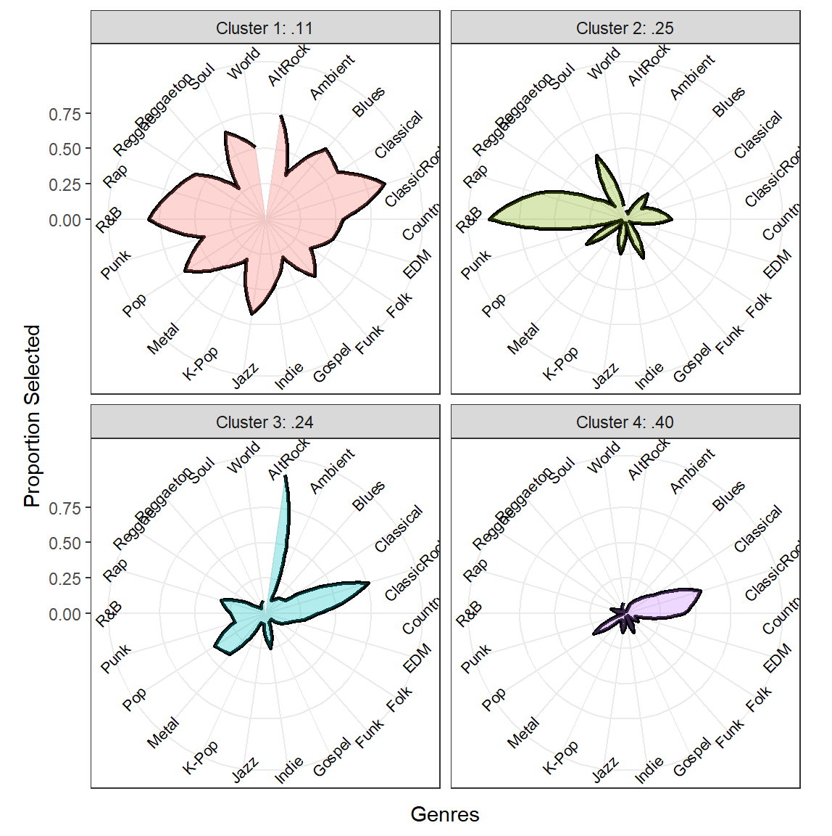
‹#›
Cluster 1: Most interested (generalists)
Cluster 2: Prefer Afro-Diasporic
Cluster 3: Prefer Americana
Cluster 4: Least Interested (picky)

Slide 10
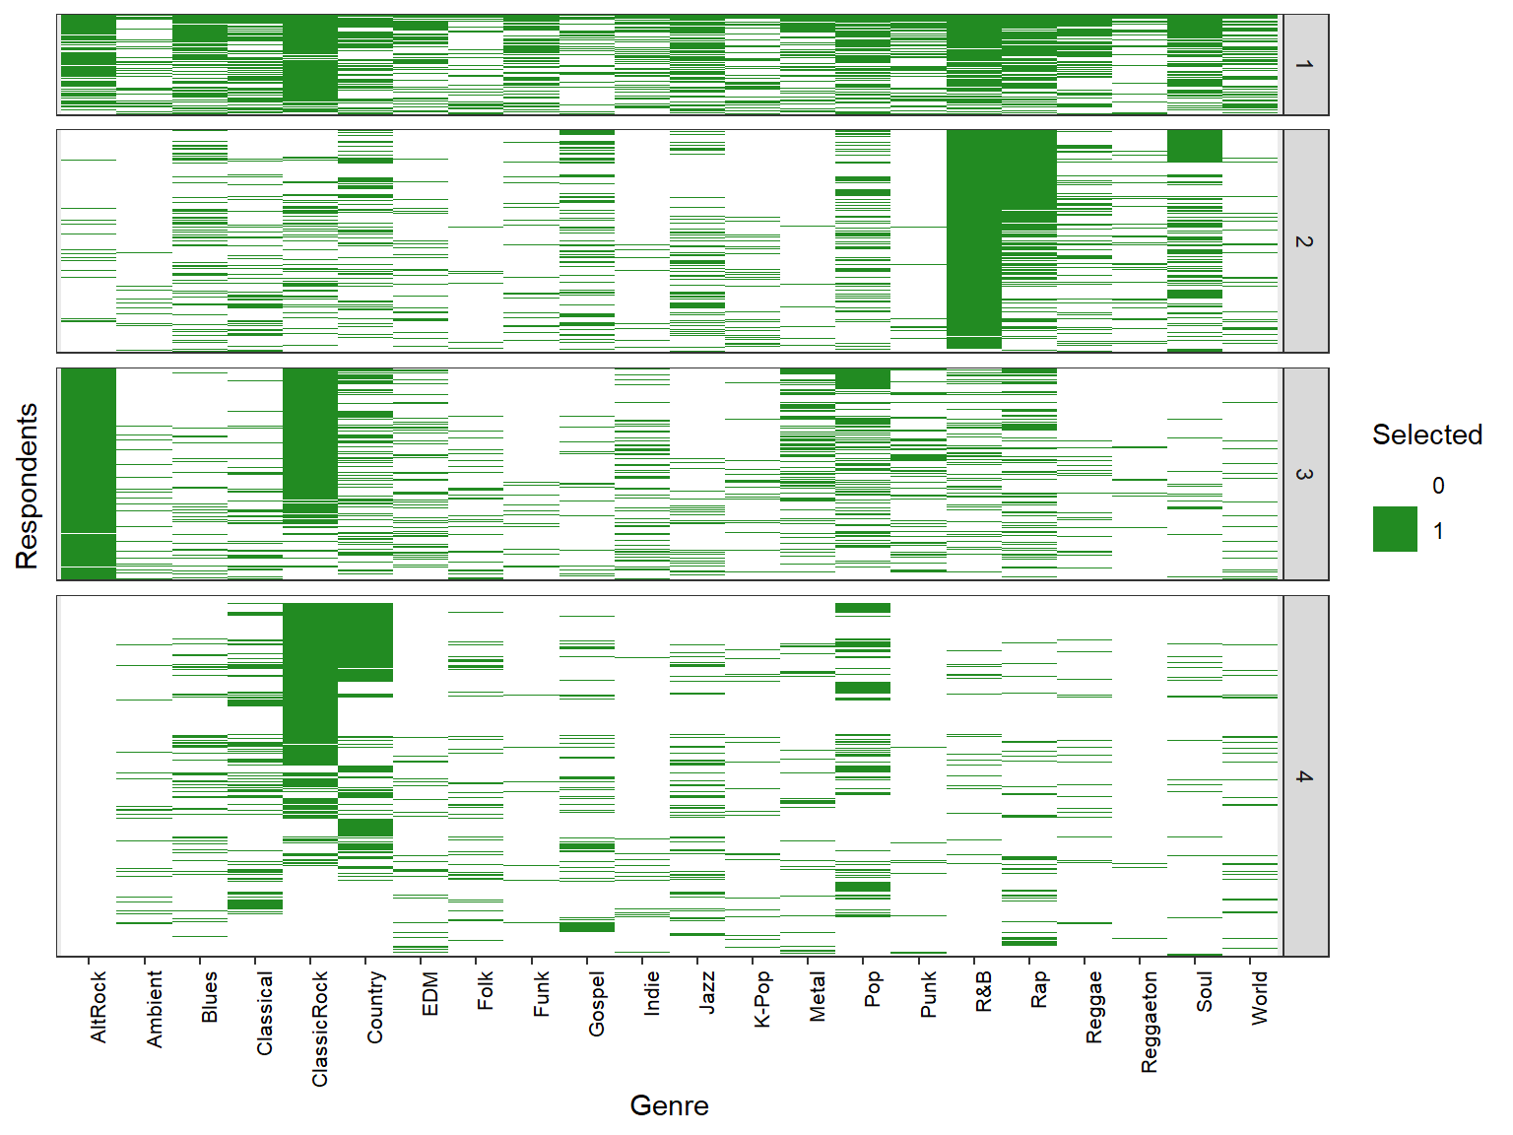
‹#›
Cluster 1: Most interested (generalists)
Cluster 2: Prefer Afro-Diasporic
Cluster 3: Prefer Americana
Cluster 4: Least Interested (picky)

Slide 11
K Means + Correlation Matrix
‹#›
Raw Data
Profile
Person | AltRock | Ambient | Blues | ClassicRock
A | 0 | 1 | 0 | 1
B | 1 | 1 | 1 | 0
C | 0 | 1 | 1 | 0
Cluster Assignment
Correlation Matrix
K Means K = 4; Euclidean Distance
A B C
1 | .4 | .2
.4 | 1 | .3
.2 | .3 | 1
C B A
Principal Component Analysis (PCA)
[0: Not Selected] [1: Selected]
Biplot Visualization

Slide 12
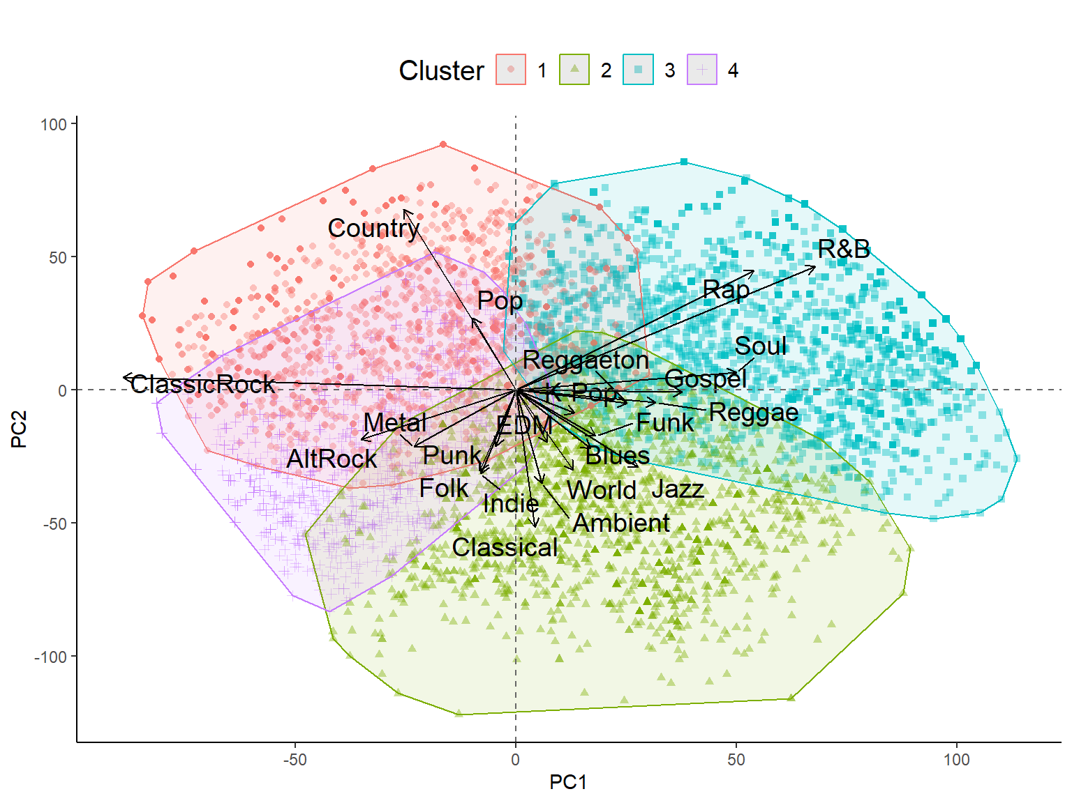
‹#›
Mainstream
Cluster 1: Mainstream Americana
Americana
Cluster 2: Eclectic
Popularity
Afro-Diasporic
Cluster 3: Mainstream Afro-Diasporic
Eclectic
Cluster 4: Eclectic Americana
Musical Heritage

Slide 13
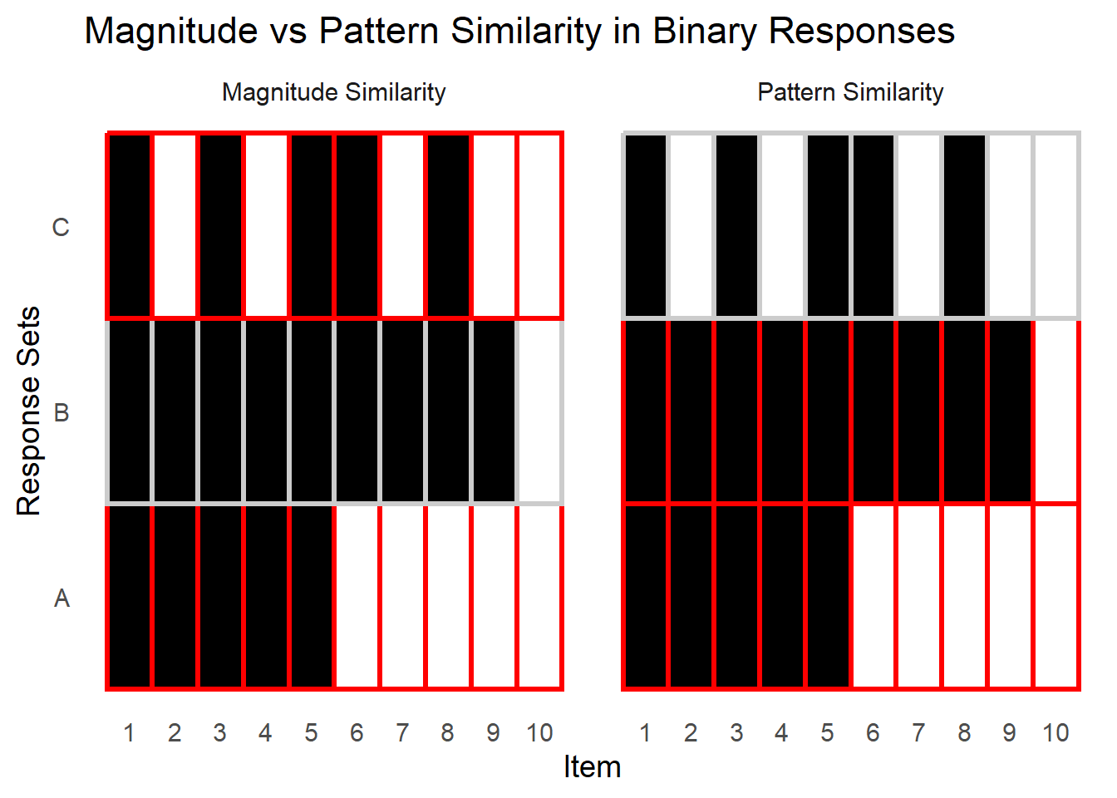
Magnitude vs. Pattern
‹#›

Slide 14
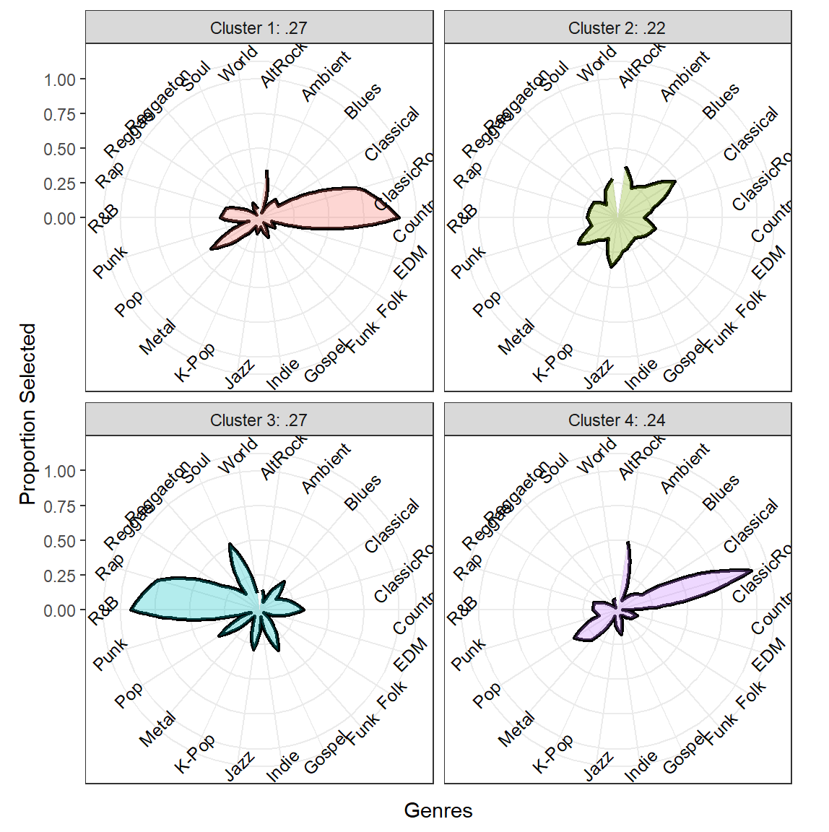
‹#›
Cluster 1: Mainstream Americana
Cluster 2: Eclectic
Cluster 3: Mainstream Afro-Diasporic
Cluster 4: Eclectic Americana

Slide 15
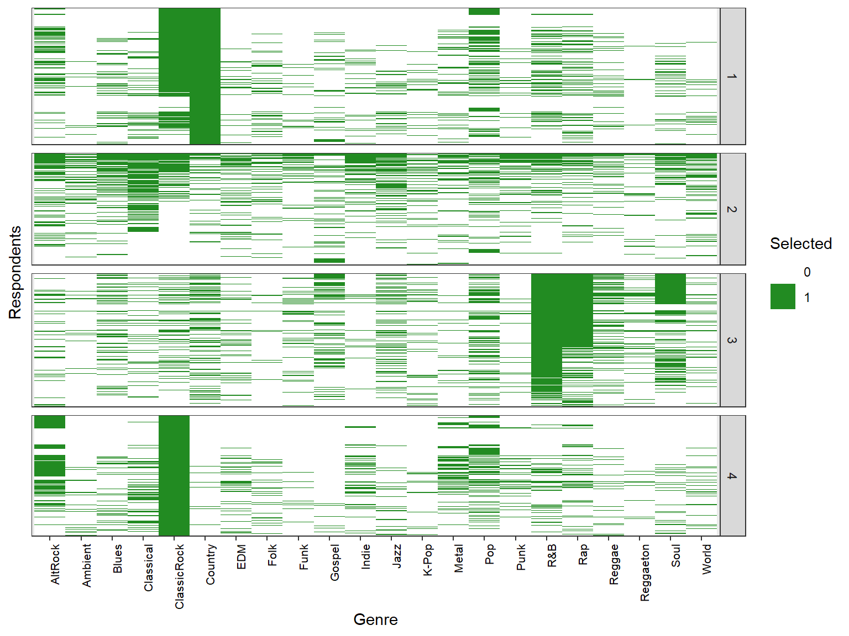
‹#›
Cluster 1: Mainstream Americana
Cluster 2: Eclectic
Cluster 3: Mainstream Afro-Diasporic
Cluster 4: Eclectic Americana

Slide 16
K Means + Jaccard Matrix
‹#›
Raw Data
Profile
Person | AltRock | Ambient | Blues | ClassicRock
A | 0 | 1 | 0 | 1
B | 1 | 1 | 1 | 0
C | 0 | 1 | 1 | 0
Jaccard
Similarity Matrix
Cluster Assignment
K Means K = 4; Euclidean Distance
A B C
1 | .4 | .2
.4 | 1 | .3
.2 | .3 | 1
C B A
Principal Component Analysis (PCA)
[0: Not Selected] [1: Selected]
Biplot Visualization

Slide 17
Jaccard Similarity
‹#›
Lower Similarity
Higher Similarity
0 | 1 | 0 | 1
1 | 1 | 1 | 0
0 | 1 | 0 | 1
1 | 1 | 0 | 1
1 Match
4 Total (where 1)
Similarity = .25
2 Match
3 Total (where 1)
Similarity = .67
Shared absence (0) is not treated as meaningful overlap Only accounts for where interest (1) is shown by at least one person
Correlation & Euclidean do consider shared 0’s as meaningful

Slide 18
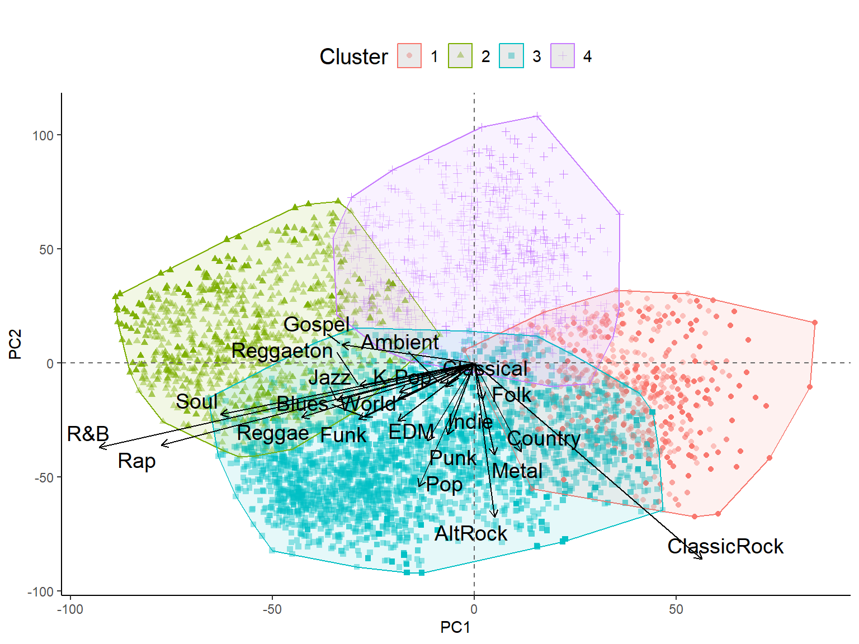
‹#›
Less Interest
Cluster 1: Prefers Americana
Afro-Diasporic
Eclectic
Cluster 2: Prefers Afro-Diasporic
Magnitude
Americana
Cluster 3: Most interested
More interest
Cluster 4: Least interested
Mainstream
Musical Heritage

Slide 19
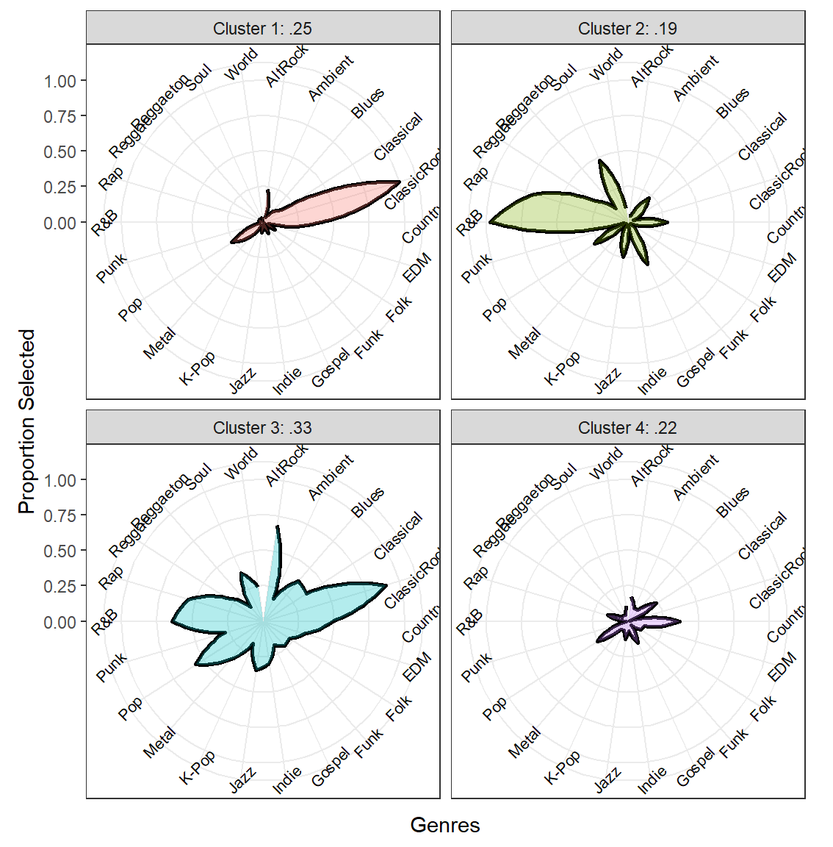
‹#›
Cluster 1: Prefers Americana
Cluster 2: Prefers Afro-Diasporic
Cluster 3: Most interested
Cluster 4: Least interested

Slide 20
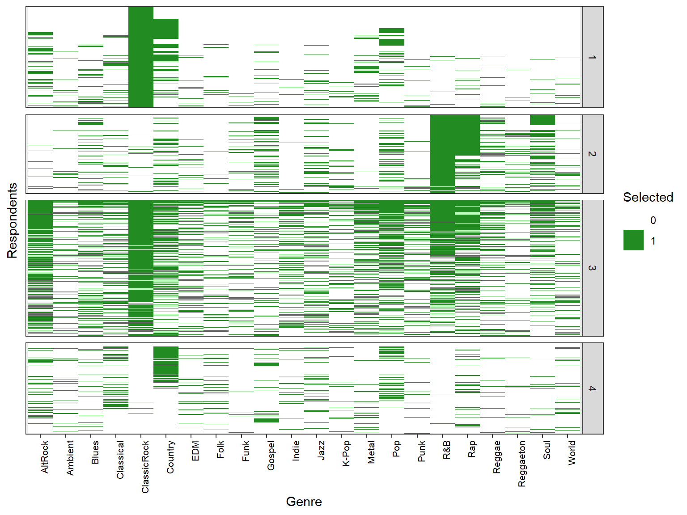
‹#›
Cluster 1: Prefers Americana
Cluster 2: Prefers Afro-Diasporic
Cluster 3: Most interested
Cluster 4: Least interested
Notes:
That it treats shared absence as not meaningful is why taste is magnified (if only choose 1 genre and others choose only that 1 genre, that is a similarity of 1).

Slide 21
LCA + Raw Data
‹#›
Raw Data
Person | AltRock | Ambient | Blues | ClassicRock | …
A | 0 | 1 | 0 | 1 | …
B | 1 | 1 | 1 | 1 | …
C | 0 | 1 | 1 | 0 | …
Profile
Cluster Assignment
Latent Class Analysis
K = 4; Probabilistic
Principal Component Analysis (PCA)
[0: Not Selected] [1: Selected]
Biplot Visualization

Slide 22
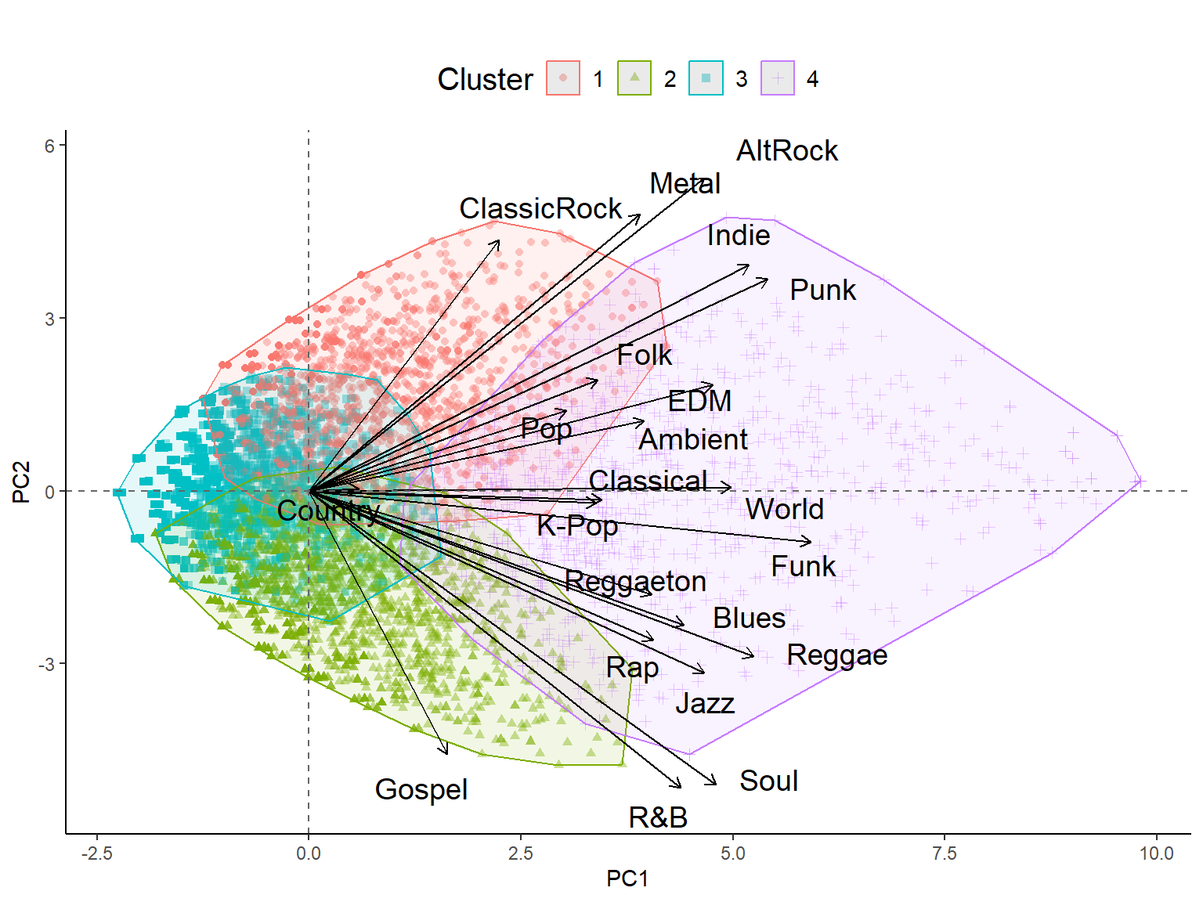
‹#›
Americana
Cluster 1: Prefer Americana
Cluster 2: Prefer Afro-Diasporic
Selects
Less Genres
Musical Heritage
Selects More Genres
Cluster 3:
Least Interested (picky)
Afro-Diasporic
Cluster 4:
Most interested (generalists)
Magnitude

Slide 23
K Means results again
‹#›
Americana
Cluster 1: Most interested (generalists)
Cluster 2: Prefer Afro-Diasporic
Selects
Less Genres
Musical Heritage
Selects More Genres
Cluster 3: Prefer Americana
Afro-Diasporic
Cluster 4: Least Interested (picky)
Magnitude

Slide 24
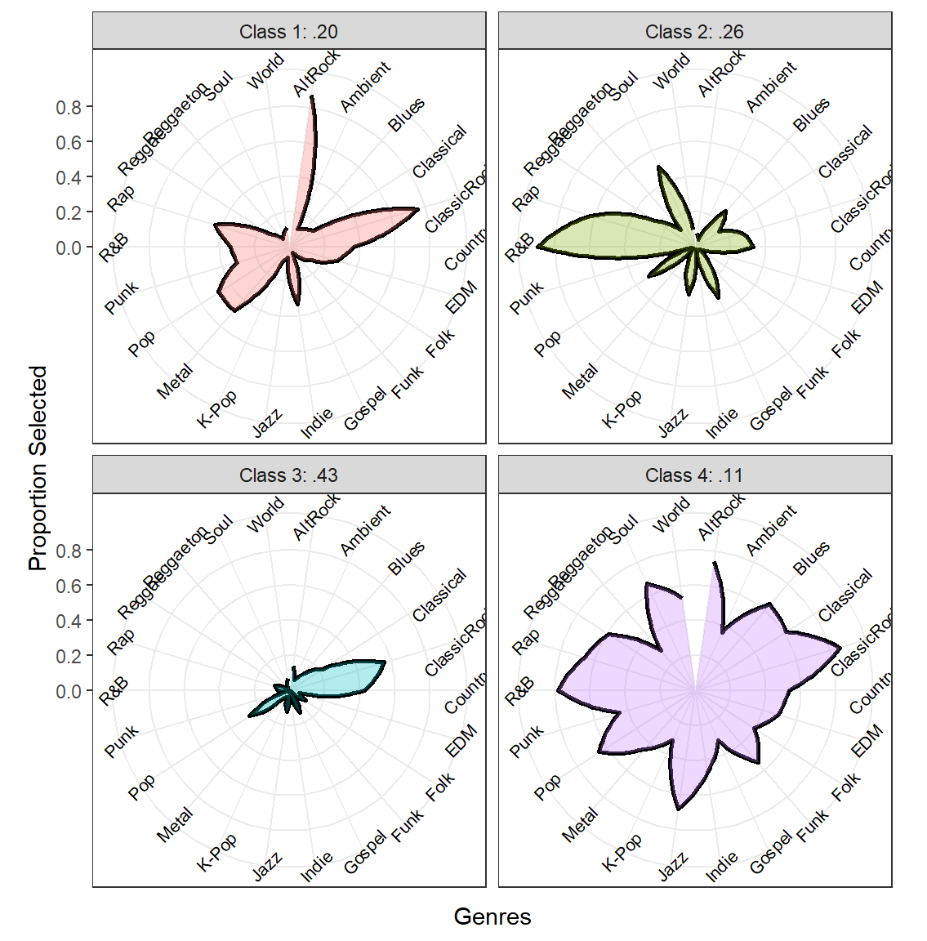
‹#›
Cluster 1: Prefer Americana
Cluster 2: Prefer Afro-Diasporic
Cluster 3:
Least Interested
Cluster 4:
Most interested (generalists)

Slide 25
Comparisons
1.
2.
3.
4.
K Means +
Raw Data
K Means + Correlation Similarity Matrix
K Means +
Jaccard Similarity Matrix
Latent Class Analysis +
Raw Data
What matters most to the project?
Captures Magnitude (PC1) and Main Taste (PC2)
Misses Nuance
Captures Main Taste (PC1) and Nuances (PC2)
Ignores Magnitude
Captures magnified Taste (PC1), Magnitude (PC2), and Nuances (harder to show)
Similar to K Means + Raw Data (for this dataset)
No forced classification (probabilities)

Slide 26
What matters?
Magnitude
Main Taste (diff)
Nuances
E.g., Maybe people who select a lot of genres have different attitudes and behavioral propensities related to a target outcome than those who choose less genres
These are typically the kind of clusters projects are looking to find, the most influential differentiations among people’s preferences
Maybe by disregarding magnitude (correlations) you identify less influential but still useful nuanced dimensions of taste (mainstream vs. eclectic)
LCA allows probabilistic assignment so you can examine cluster fuzziness (error)

Slide 27
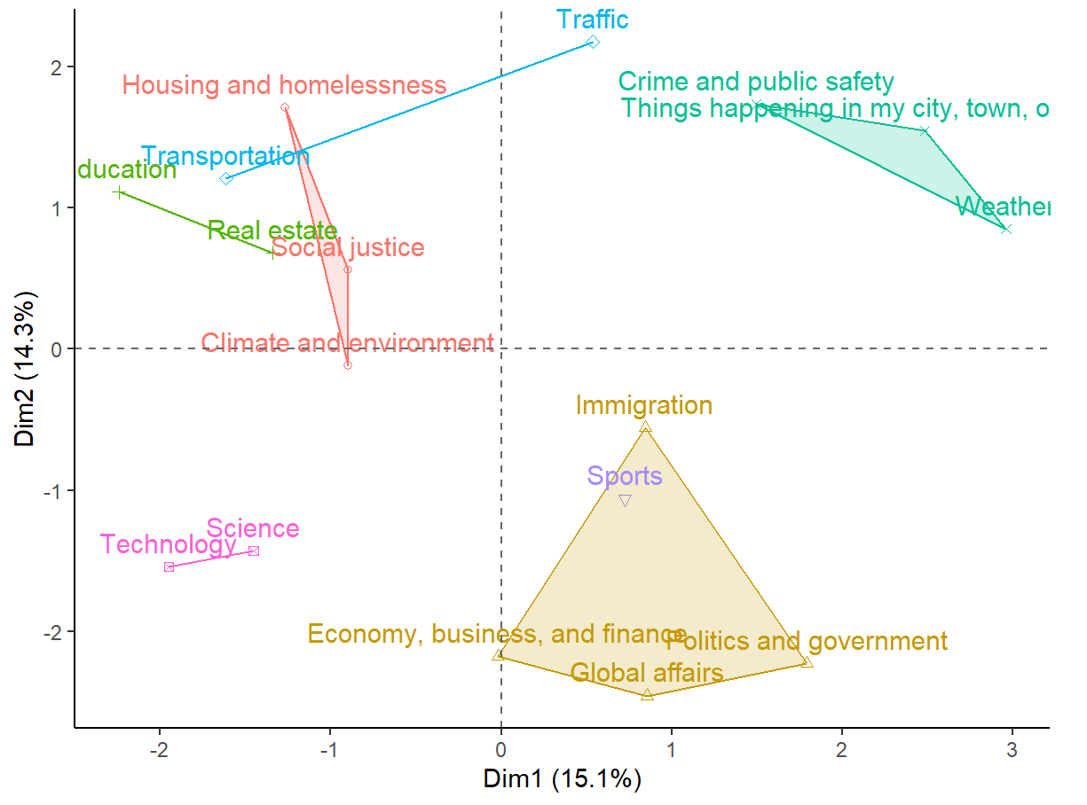
Item Segments: News Topics
‹#›
Local Scale
Broad/Systemic Issues
Civic Immediacy
Current Events
Large Scale

Slide 28
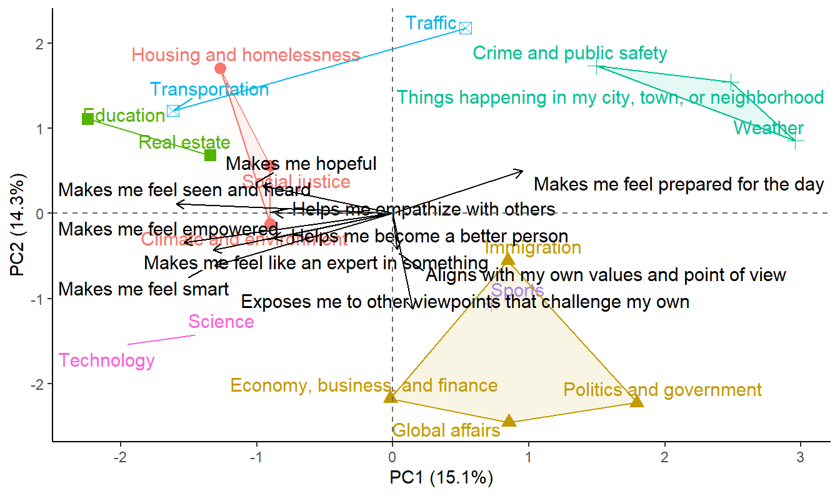
Topics x Gratifications
‹#›
Local Scale
Broad/Systemic Issues
Civic Immediacy
Current Events
Large Scale
Notes:
PC1 separates pragmatic, civic utility from self-expressive and growth-oriented uses of news.
Right: news as daily tool.
Left: news as personal enrichment or empowerment.
PC2 contrasts moral-intellectual engagement (bottom) with emotional or relational engagement (top).

Slide 29
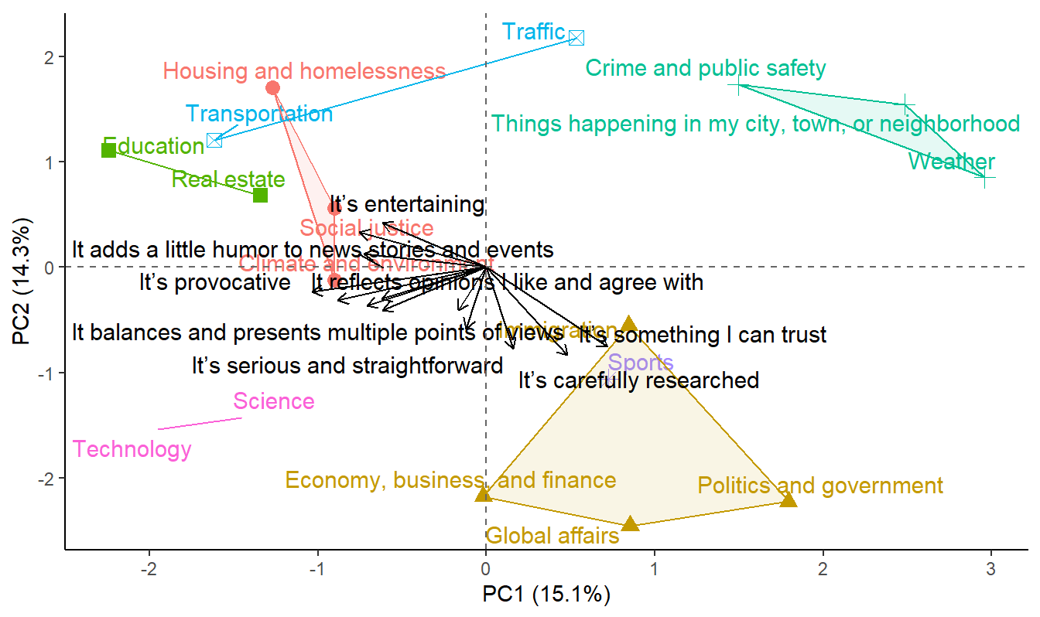
Topics x Characteristics
‹#›
Local Scale
Broad/Systemic Issues
Civic Immediacy
Current Events
Large Scale

Slide 30
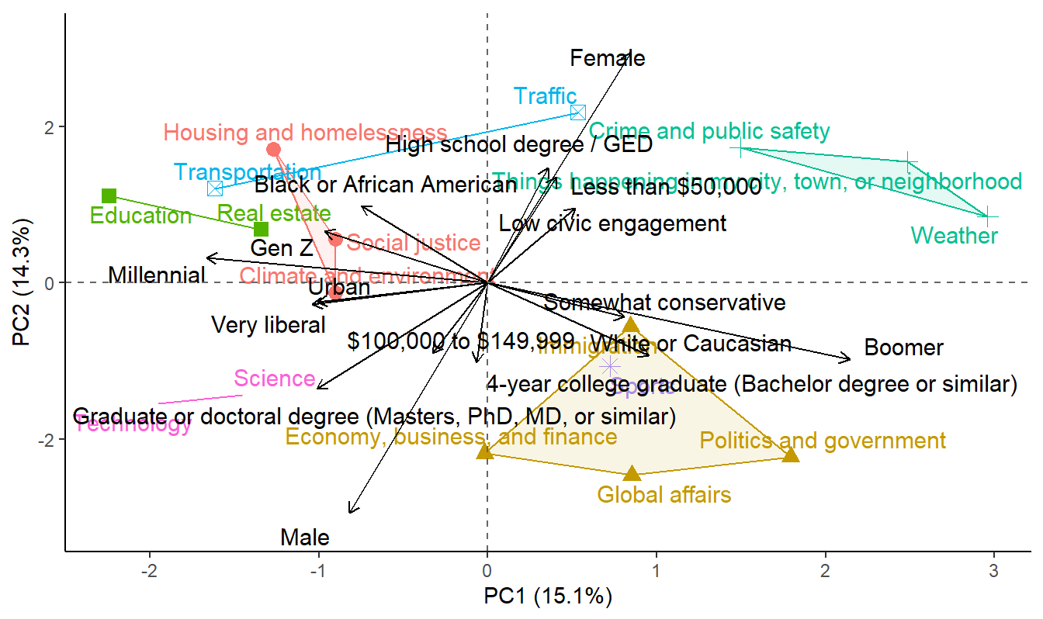
Topics x Demographics
‹#›
Local Scale
Broad/Systemic Issues
Civic Immediacy
Current Events
Large Scale

Slide 31
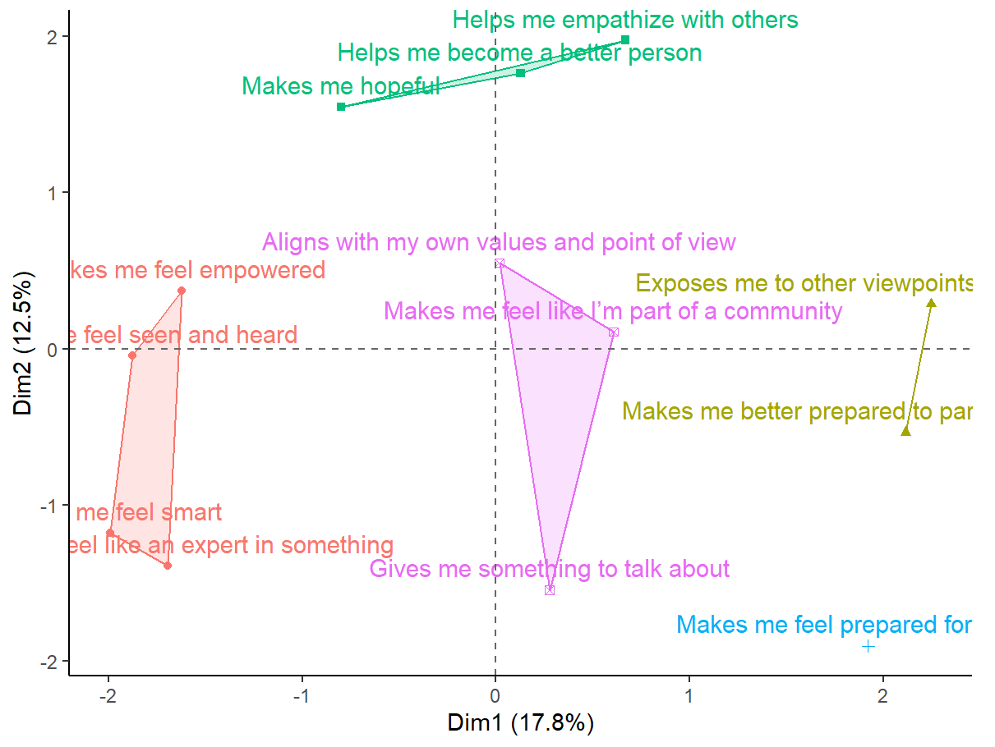
Gratifications
‹#›
Affective/Moral
Self-Enhancement/Affirming
Civic/Altruistic
Cognitive/Pragmatic

Slide 32
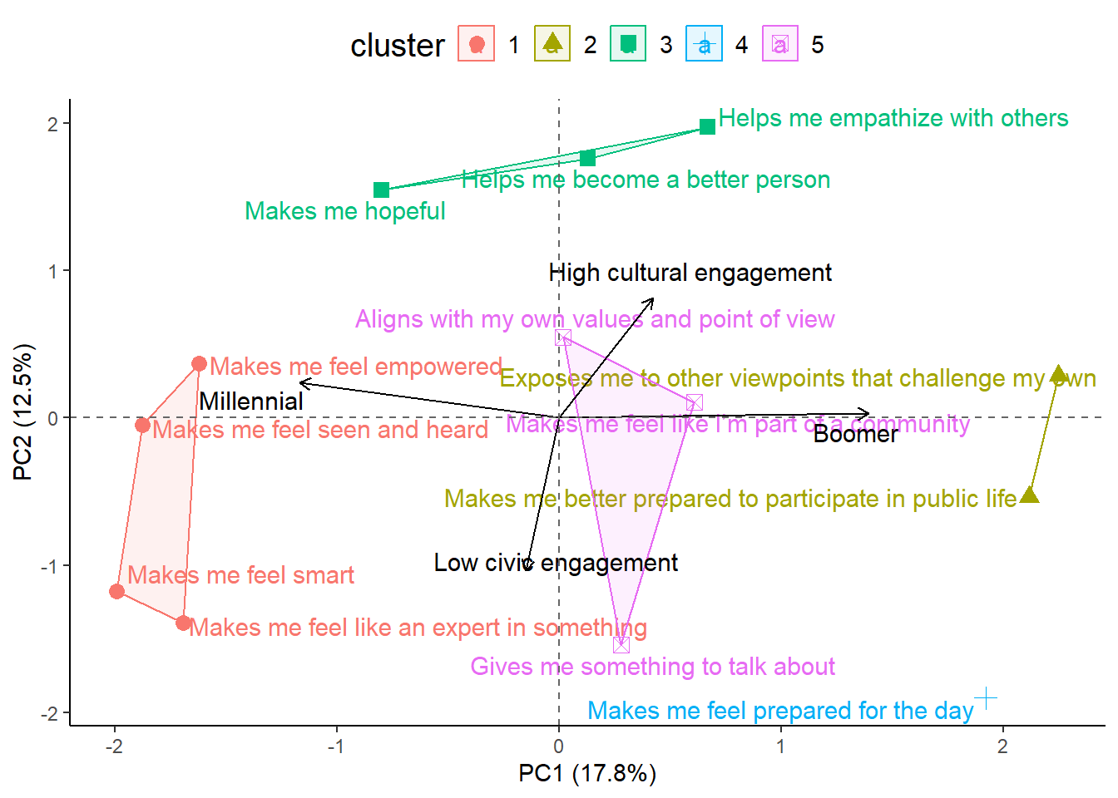
Gratifications X Demos
‹#›
Affective/Moral
Self-Enhancement/Affirming
Civic/Altruistic
Cognitive/Pragmatic

Slide 33
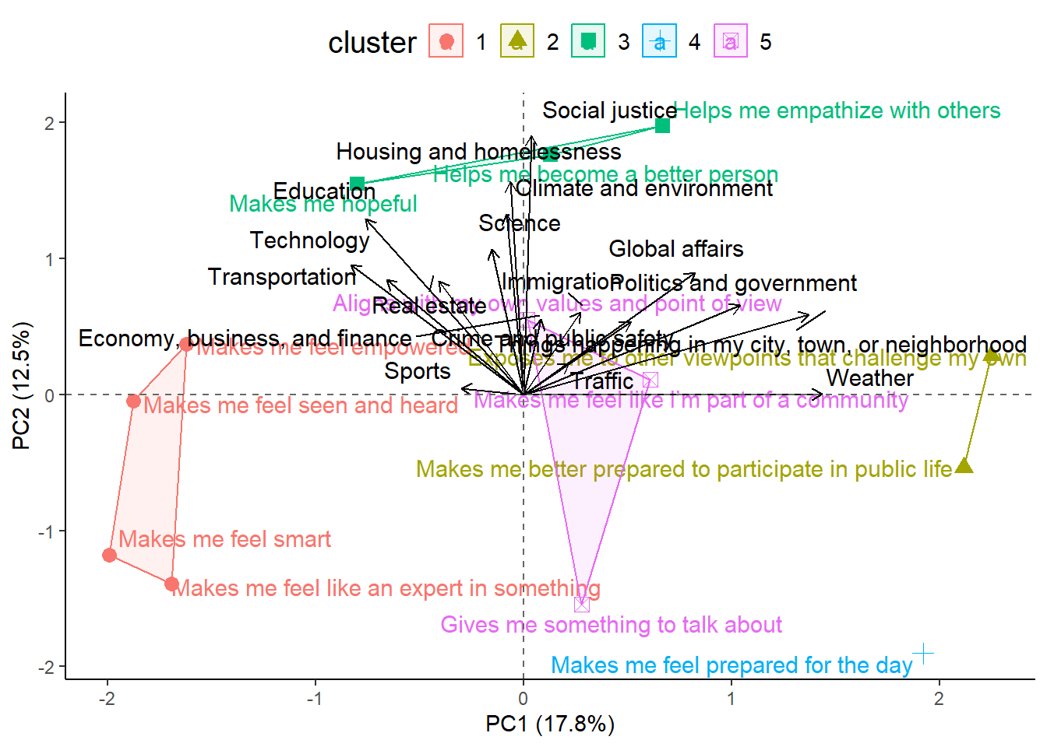
Gratifications X Topics
‹#›
Affective/Moral
Self-Enhancement/Affirming
Civic/Altruistic
Cognitive/Pragmatic

Slide 34
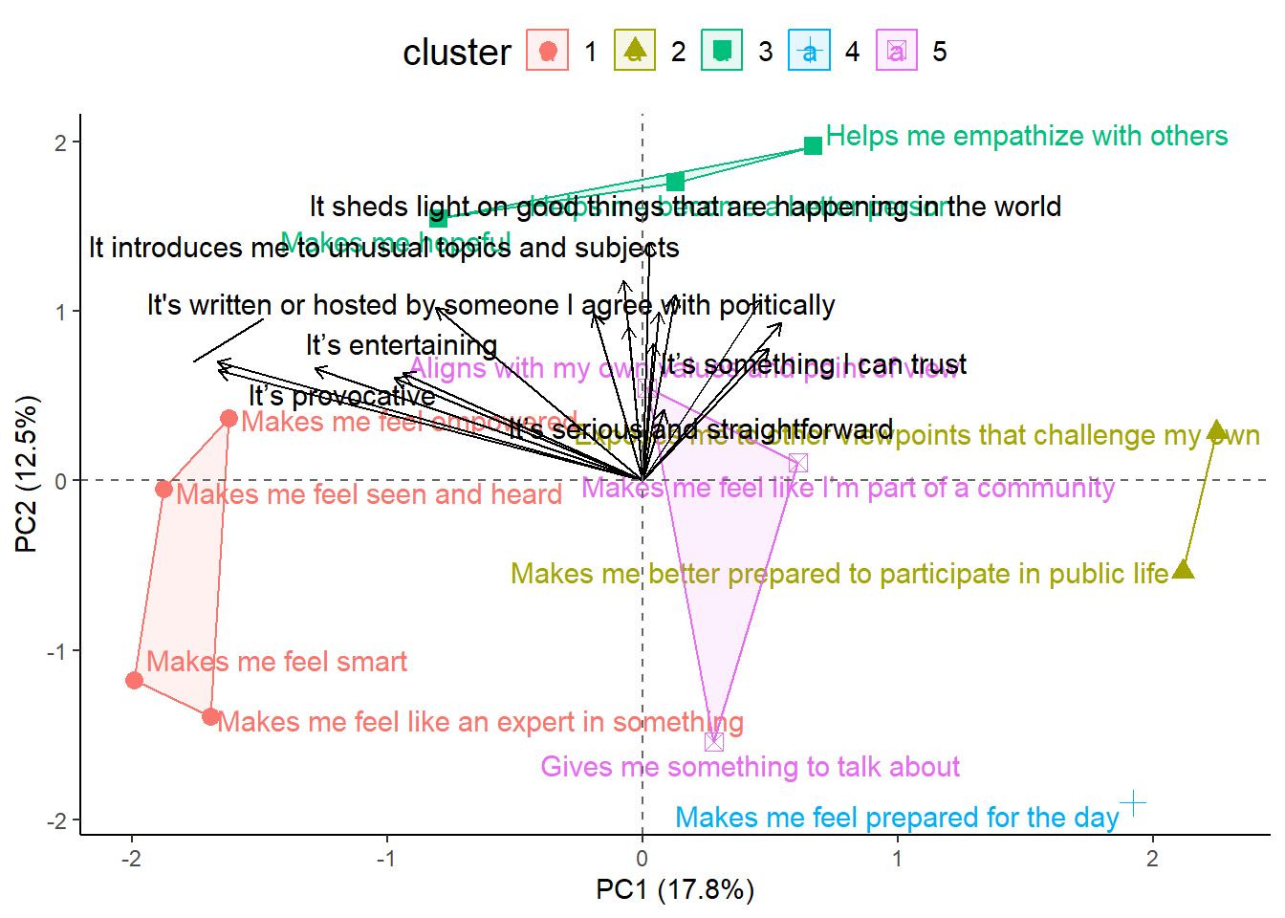
Gratifications X Characteristics
‹#›
Affective/Moral
Self-Enhancement/Affirming
Civic/Altruistic
Cognitive/Pragmatic
Notes:
Most qualities people value in news — regardless of type — are understood as emotionally or morally meaningful, rather than merely utilitarian.
But within that moral space, there’s a split between:
Civic-integrity qualities (research, balance, trust, multiple perspectives), and
Self-affirming / affective qualities (entertaining, provocative, partisan).

Slide 35
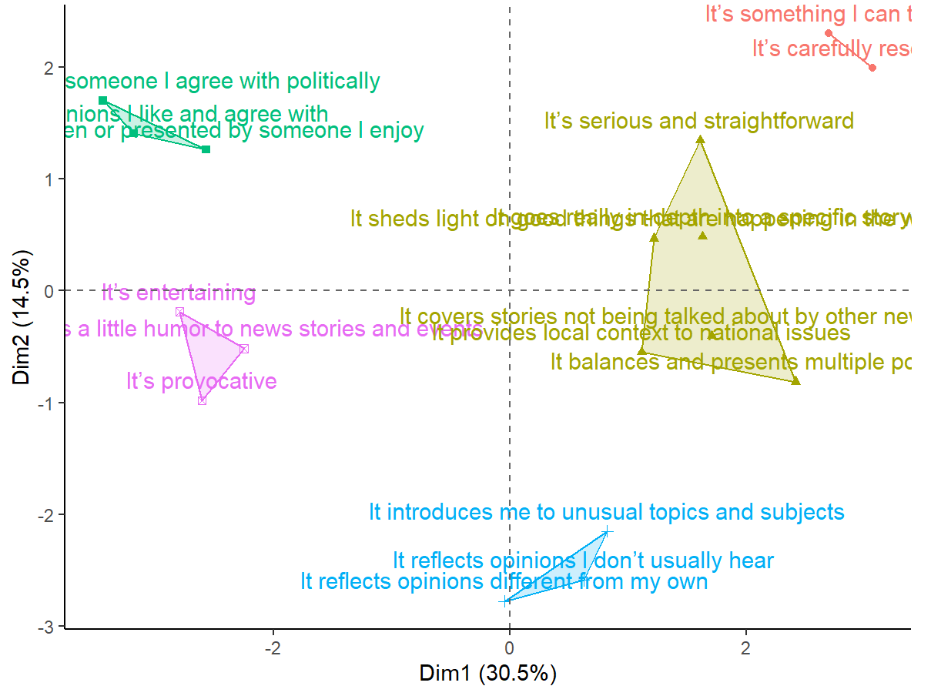
Characteristics x Demos
‹#›
Familiar/Comforting
Personality
Entertainment
Credibility
Challenging/Novel

Slide 36
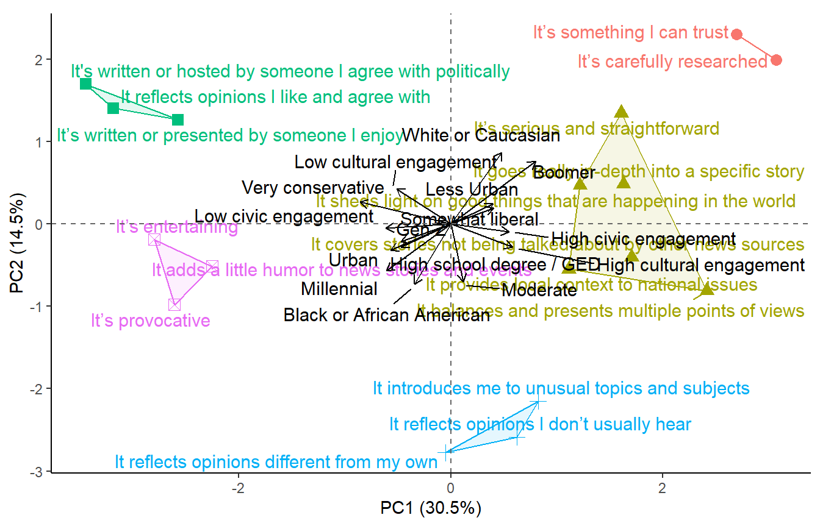
Characteristics x Demos
‹#›
Familiar/Comforting
Personality
Entertainment
Credibility
Challenging/Novel

Slide 37
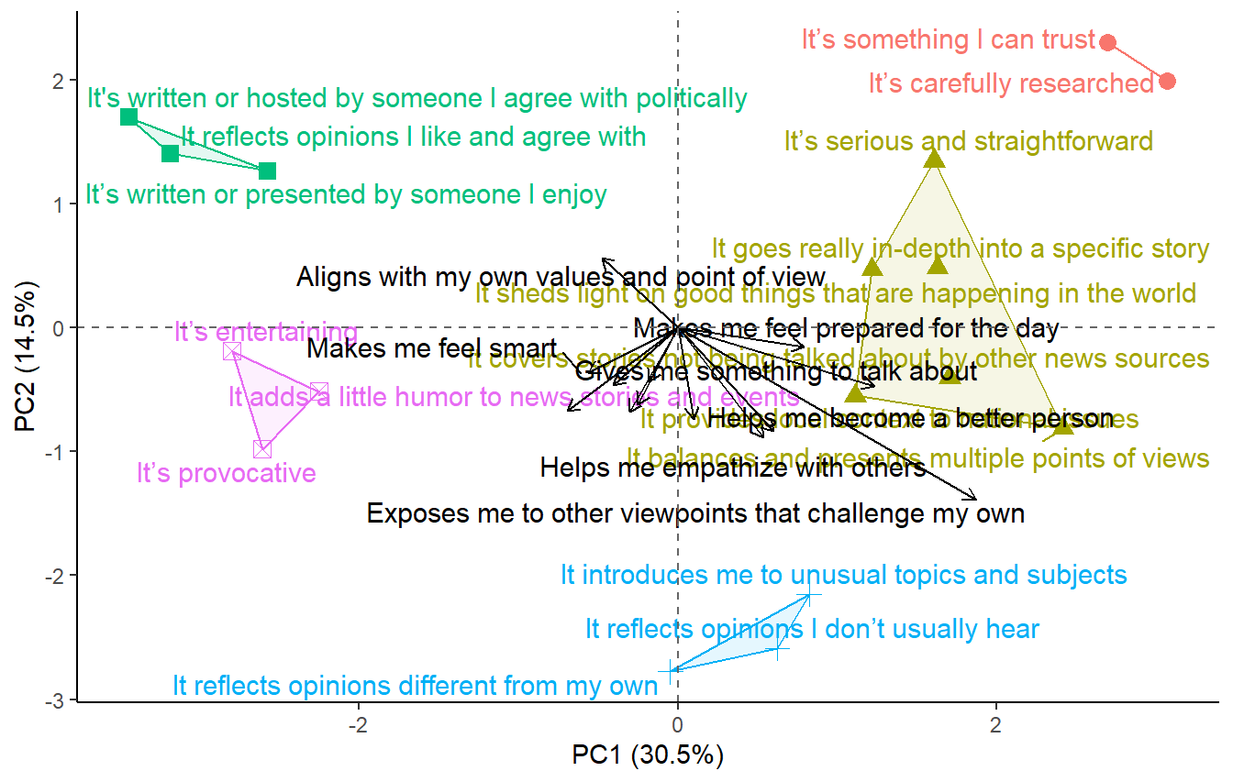
Characteristics x Gratifications
‹#›
Familiar/Comforting
Personality
Entertainment
Credibility
Challenging/Novel

Slide 38
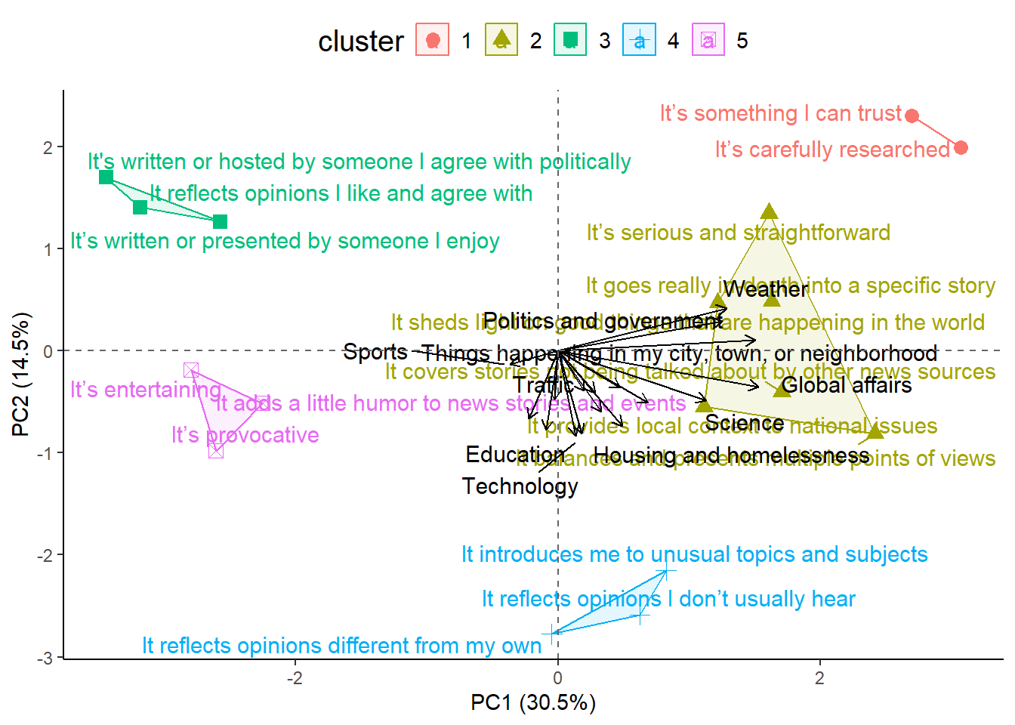
Characteristics x Topics
‹#›
Familiar/Comforting
Personality
Entertainment
Credibility
Challenging/Novel

